Slide 1
PRESENT

Slide 2
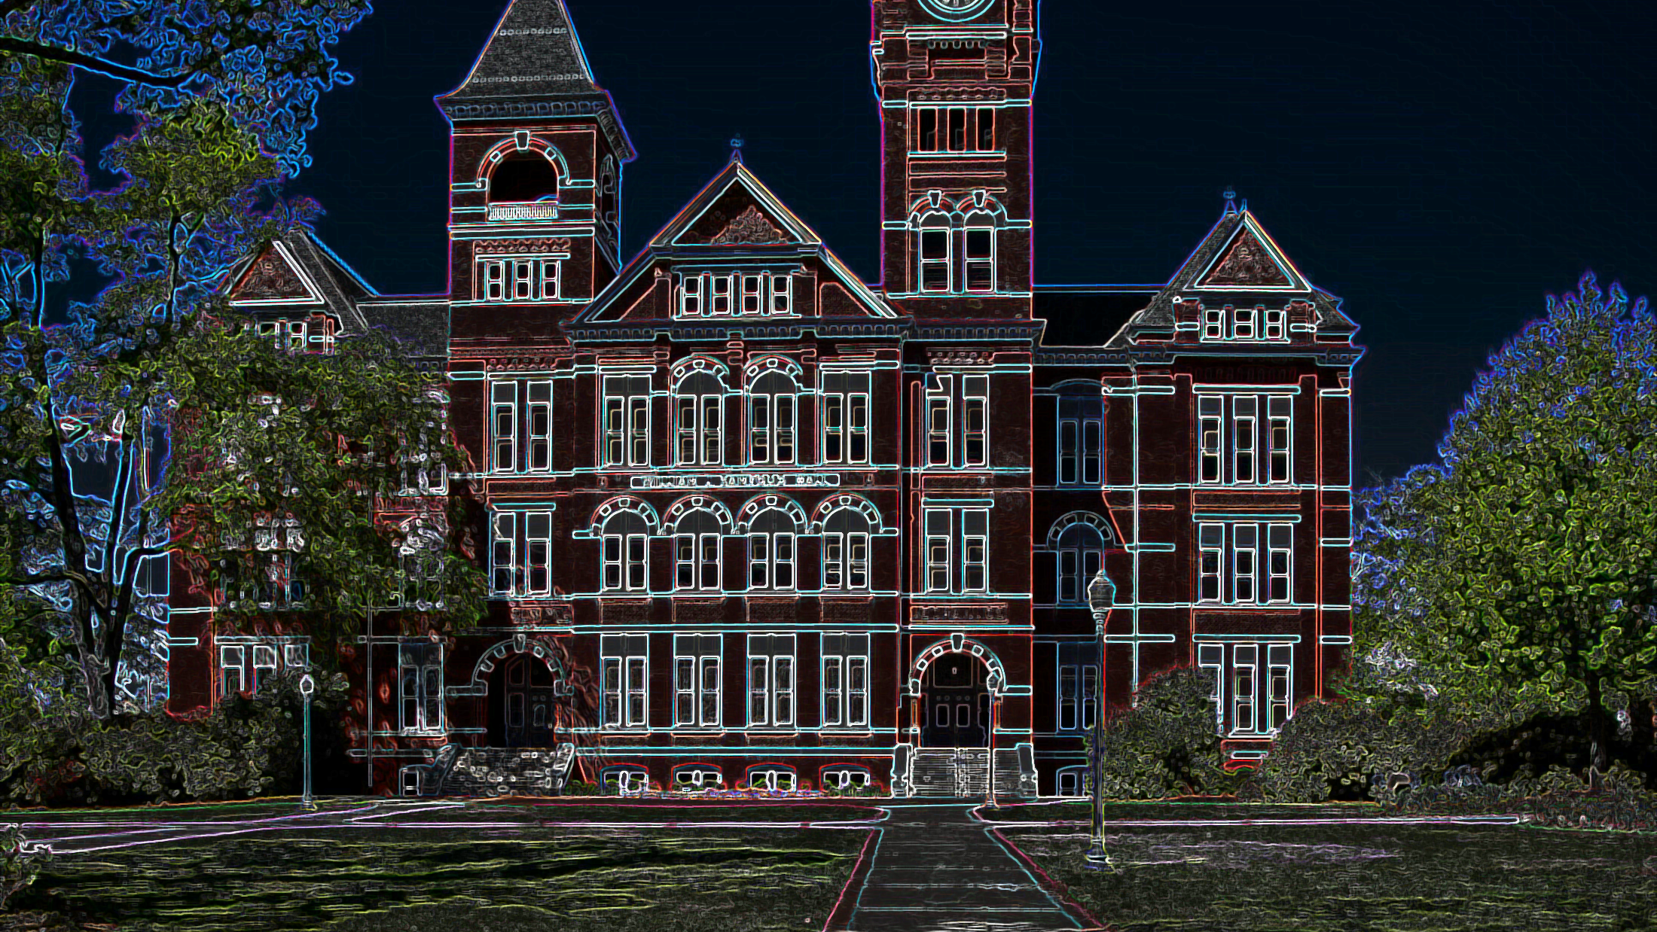
ESCAPE ROOM TRAPPED AT SCHOOL

Slide 3
Insert date
it’s the big day of the school trip to [insert destination]. Your parents have given you thousands recommendations, but you can’t wait to have an unforgettable day. [Insert name] has forgotten its backpack in the classroom. You and a small group of classmates decide to wait for him in the school hall.

Slide 4
Inserire data
All classes are already waiting in the bus and the school without students has a rather ghostly appearance.

Slide 5
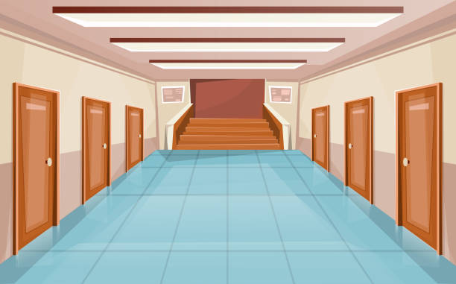

Slide 6
The history teacher HAD BEEN VERY CLEAR: NEVER LEAVE THE GROUP. YET IT TOOK just A SECOND TO LOSE SIGHT of the teacher and the other classmates.

Slide 7
your PROBLEMS ARE NOT OVER: NOT ONLY DO THE other CLASSmates SEEMS TO HAVE vanished, BUT THE ENTRANCE DOOR IS locked.

Slide 8
There is no one around you to ask for help. You are trapped at school!

Slide 9
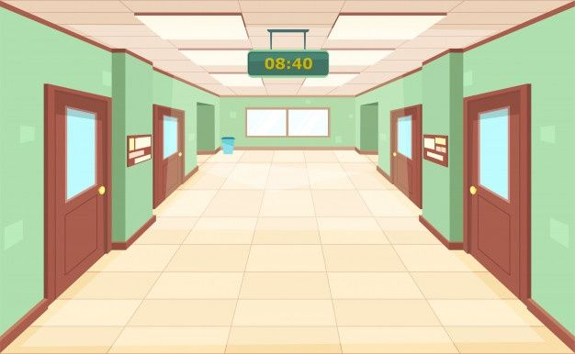
YOU AND YOUR Classmates ARE STUCK IN THE HALLWAY. “I never realized how spacious the hall was,” [insert name] SAYS. “What’s a globe doing on the floor?” [insert name] asks. Identify the names of the colored nations.

Slide 10
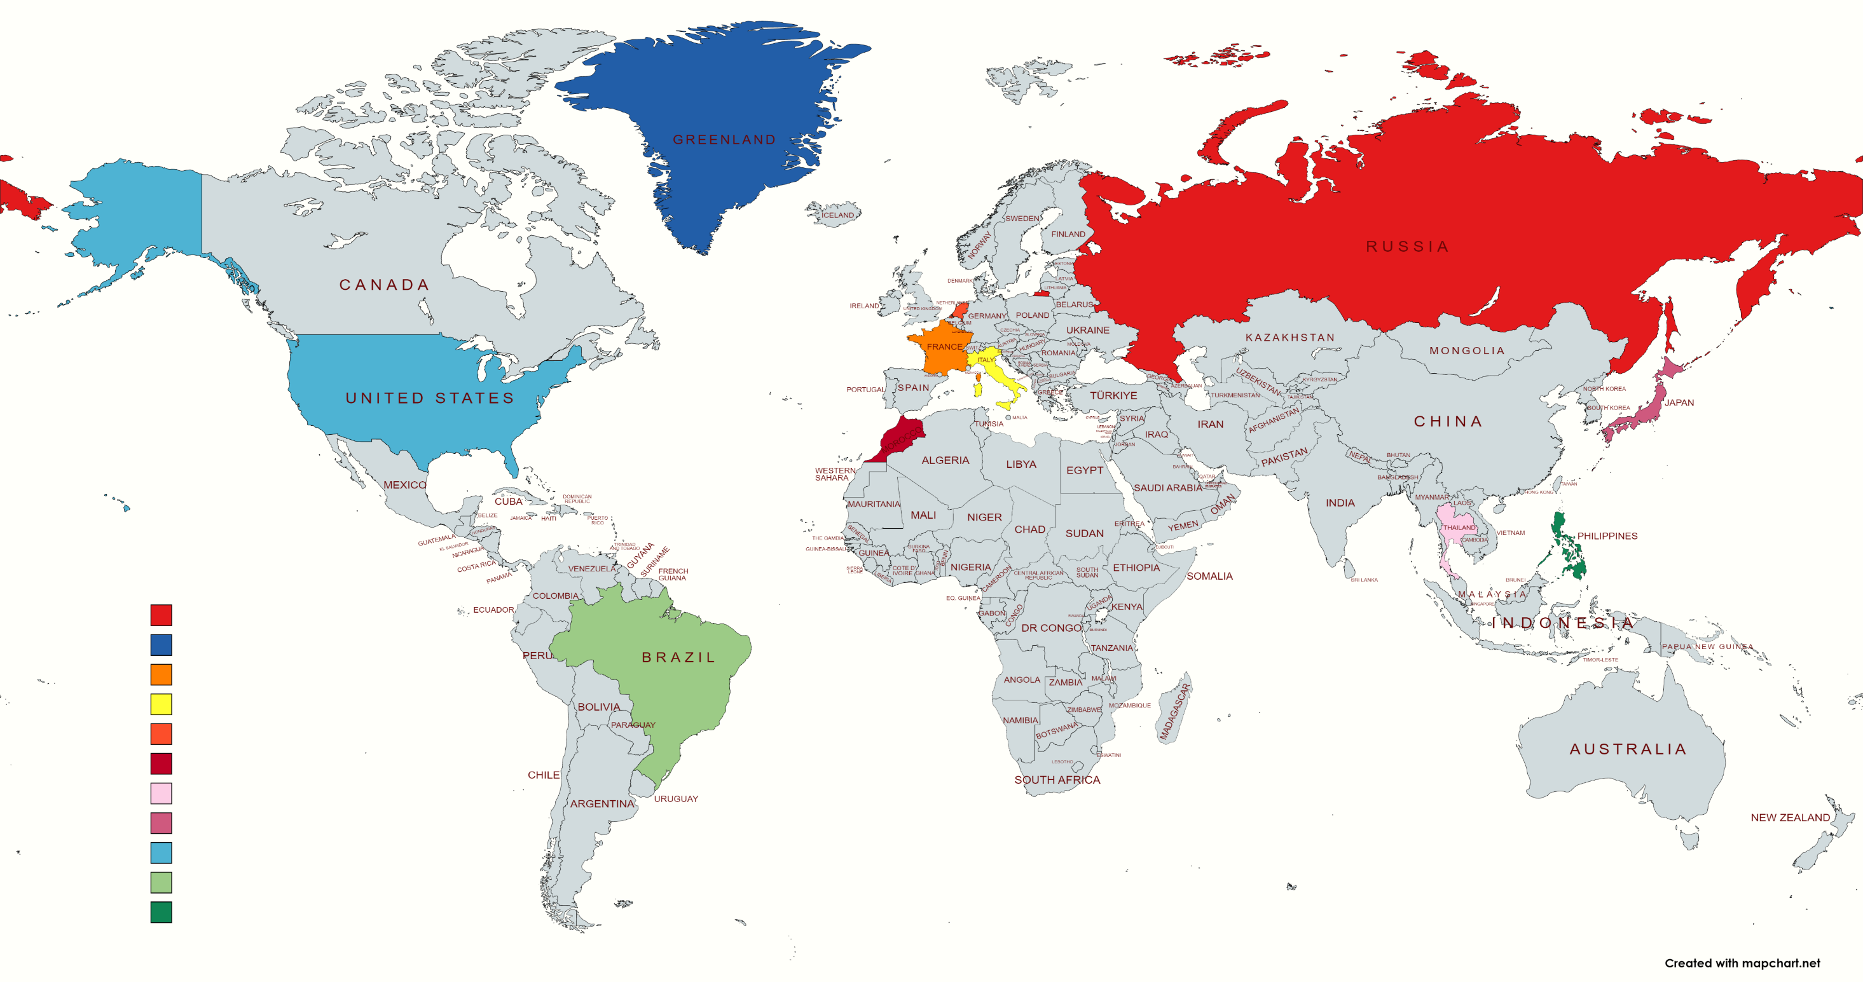

Slide 11
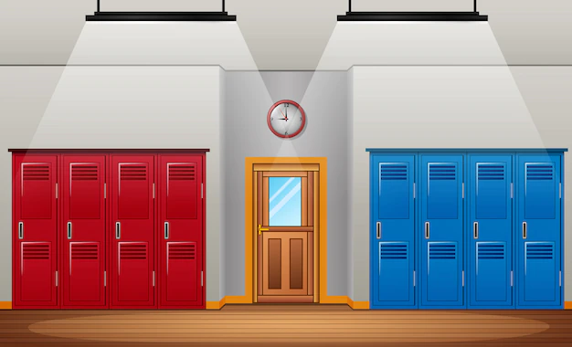
Ring a bell
xxxx
xxxx

Slide 12
Level completed

Slide 13
Level NOt completed

Slide 14
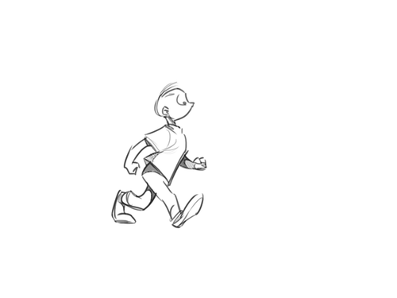
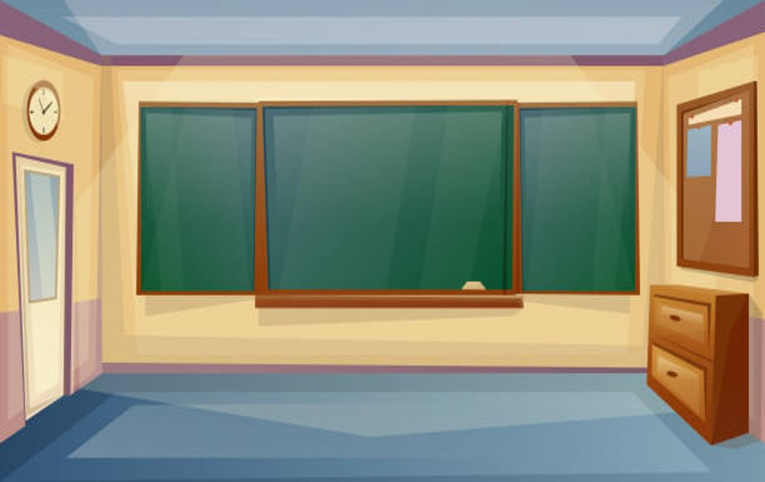
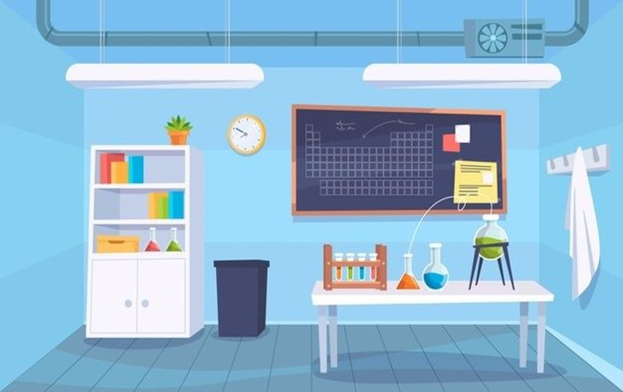
IT’S TIME TO GO…
classroom
Science lab

Slide 15
[insert text]

Slide 16
[insert text]

Slide 17
Click here

Slide 18
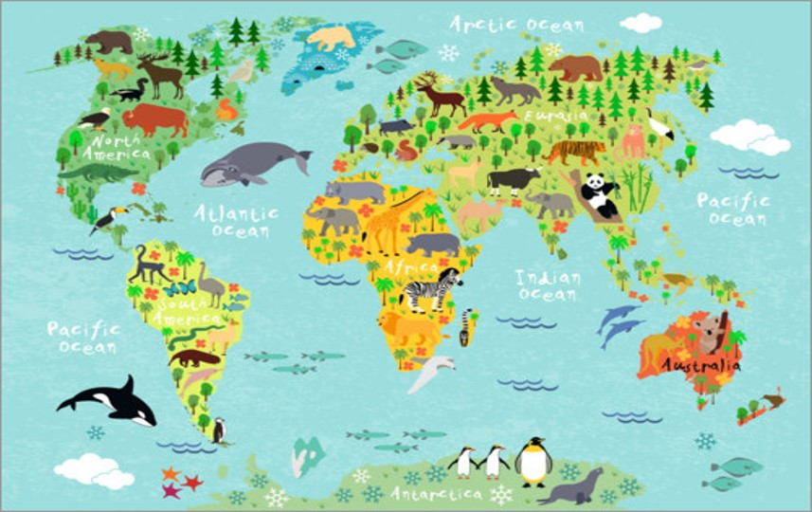
IT’S TIME TO GO…
GLOBE CLASS
Library

Slide 19
[insert text]

Slide 20
[insert text]

Slide 21
Ring a bell
xxxx
xxxx

Slide 22
Level completed

Slide 23
Level NOt completed

Slide 24
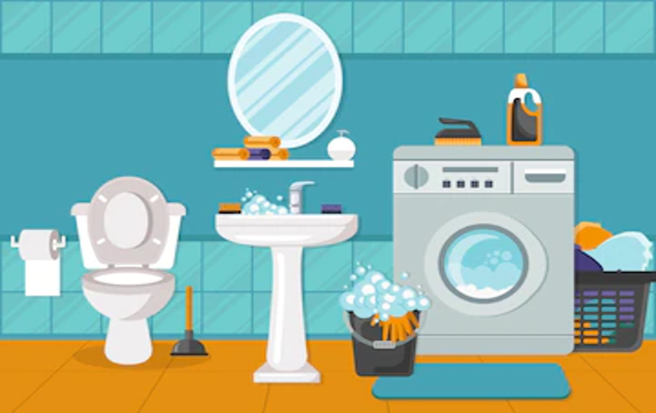
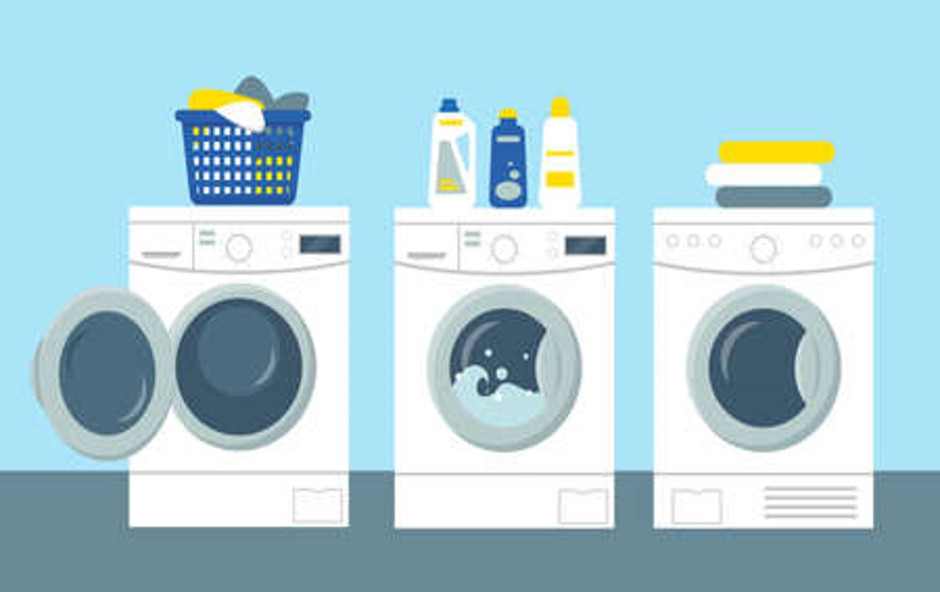
IT’S TIME TO GO…
bathroom
laundry

Slide 25
[insert text]

Slide 26
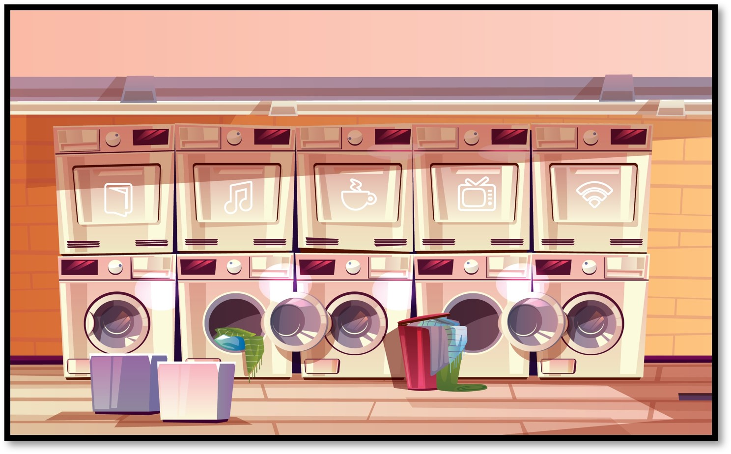
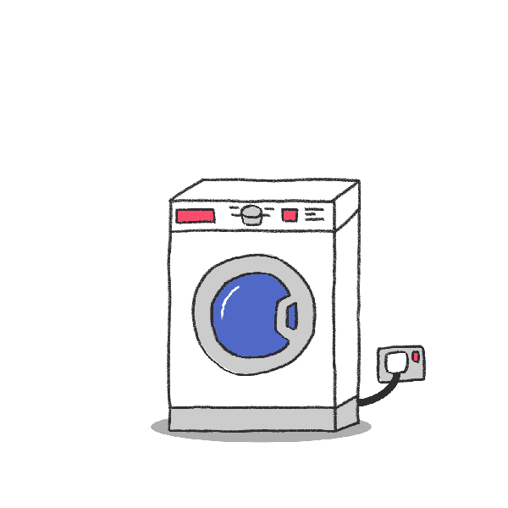
[insert text]

Slide 27
Click here

Slide 28
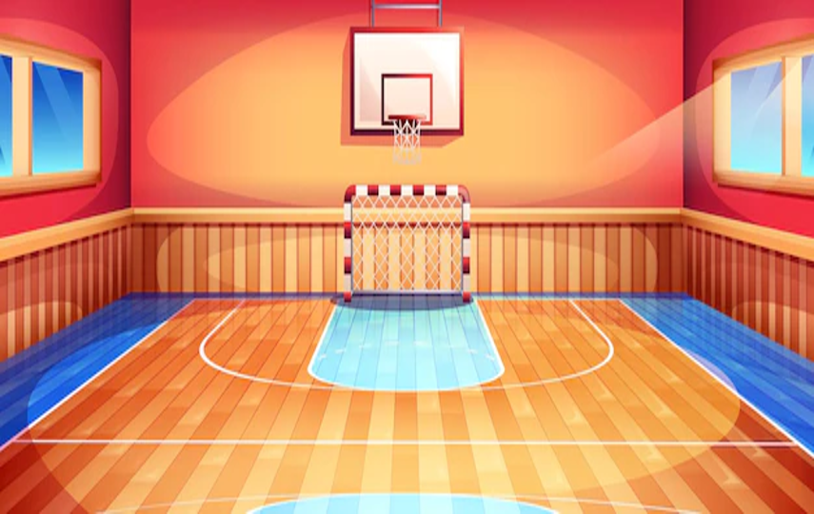
IT’S TIME TO GO…
It lab
gym

Slide 29
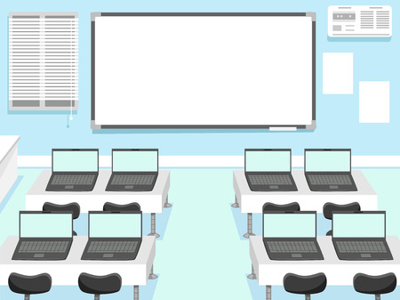

Slide 31
Ring a bell
xxxx
xxxx

Slide 32
Level completed

Slide 33
Level Not completed

Slide 34
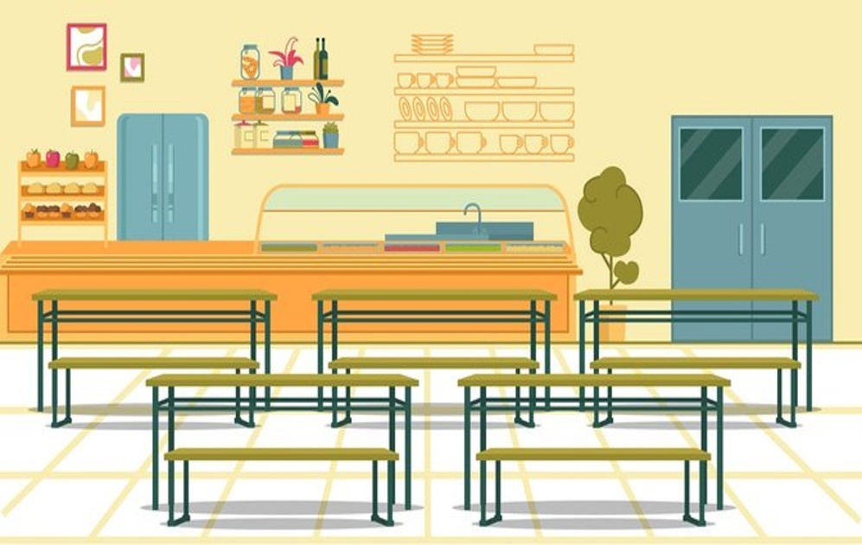
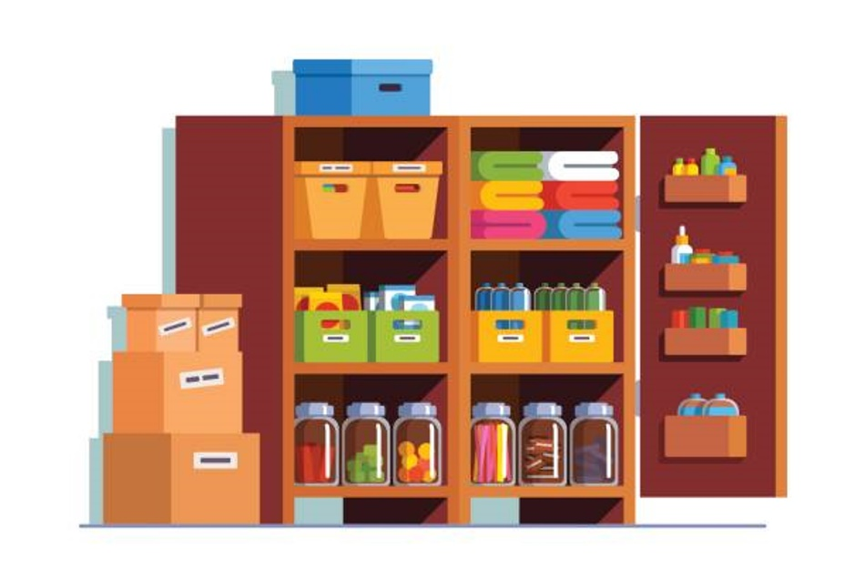
IT’S TIME TO GO…
canteen
Utility room

Slide 35
[insert text]

Slide 36
[insert text]

Slide 37
Ring a bell
xxxx
xxxx

Slide 38
Level completed

Slide 39
Level Not completed

Slide 40
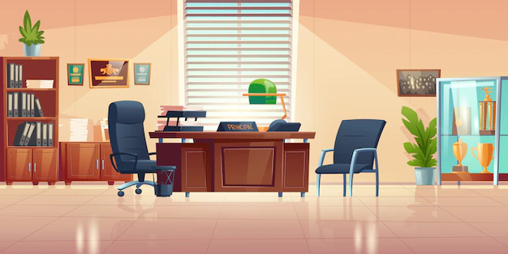
IT’S TIME TO GO…
Headmaster’s office

Slide 42
Click here

Slide 43
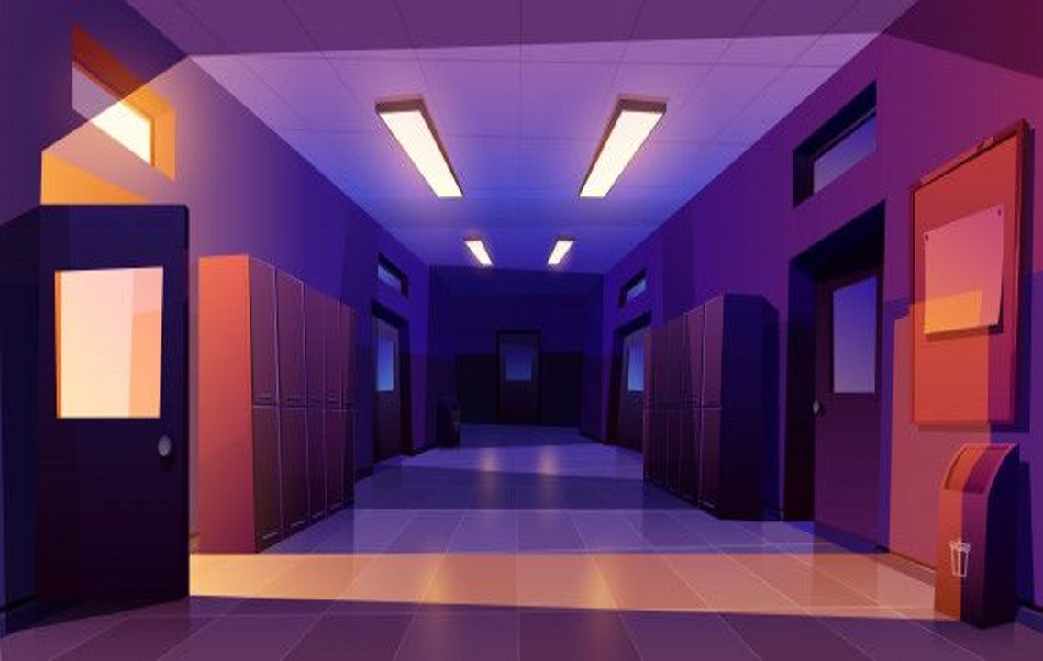
[insert text]

Slide 44
Ring a bell
xxxx
xxxx

Slide 45
Level completed

Slide 46
Level NOt completed

Slide 47
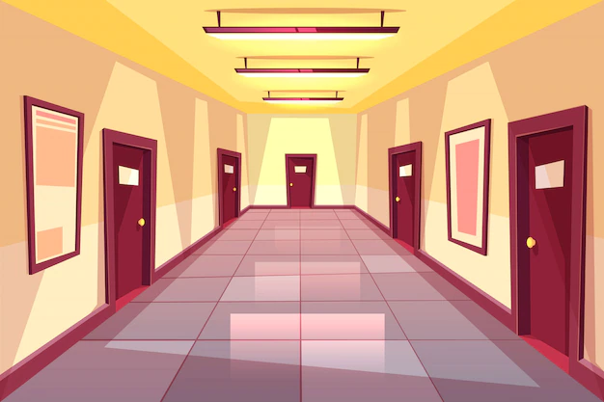
[insert text]
xxxx
xxxx
xxxx
xxxx
The sixth word costs 2 minutes
xxxx
The first letter costs 3 minutes

Slide 48
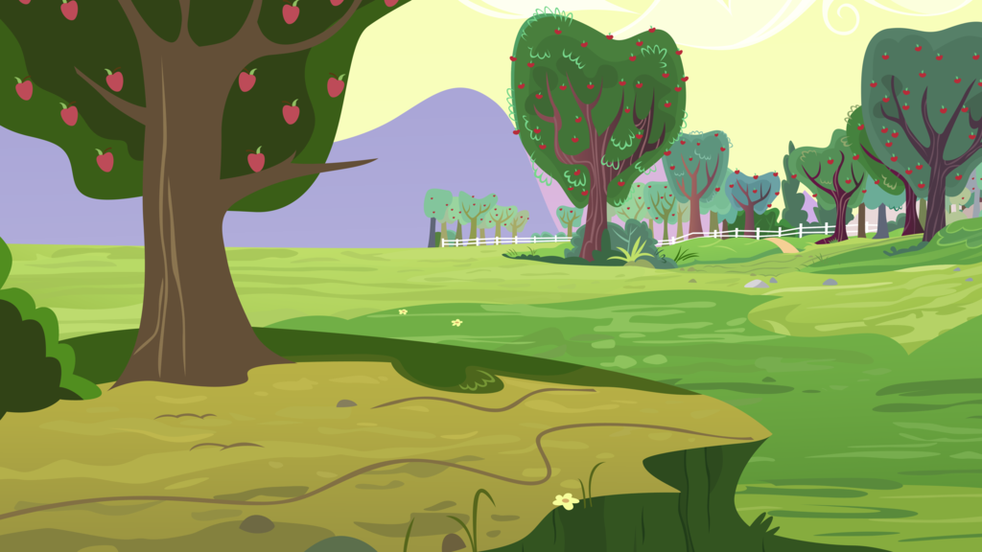
Dear students, YOU HAVE MANAGED TO ESCAPE THROUGH THE UNDERGROUND. YOU HAVE REACHED YOUR GOAL AND got THE MOST PRECIOUS GOOD: FREEDOM! IN THE NEXT FEW DAYS YOU will FIND OUT IF THE WORD IS RIGHT AND IF YOU HAVE MANAGED TO WIN OVER YOUR OPPONENTS.

